Slide 1
IBM Capstone project
Battle of Neighborhoods
Report by
Michael Sekyere

Slide 2
Introduction
The population of New York City has grown considerably over the last decades. With its diverse culture, comes diverse way of living for the people of New York. Notably, the different kinds of lifestyles, music genres, dressing, movies, foods, languages, etc.
In this project, I will list and visualize all major parts of New York City that has great Italian restaurants. I will also compare neighborhoods where customer gives the best tips and ratings about Italian restaurant in order to determine which neighborhood has the best customers for Italian dishes

Slide 3
DATA SOURCES
https://cocl.us/new_york_dataset
Foursquare API Description.
GeoSpace data source: https://data.cityofnewyork.us/City-Government/Borough-Boundaries/tqmj-j8zm

Slide 4
METHODOLOGY
Collect the New York City data from https://cocl.us/new_york_dataset
Using Foursquare API we will find all venues for each neighborhood.
Filter out all venues that are Italian Restaurants.
Find rating, tips and like count for each Italian Restaurants using Foursquare API.
Using rating for each restaurant, we will sort that data.
Visualize the Ranking of neighborhoods using folium library

Slide 5
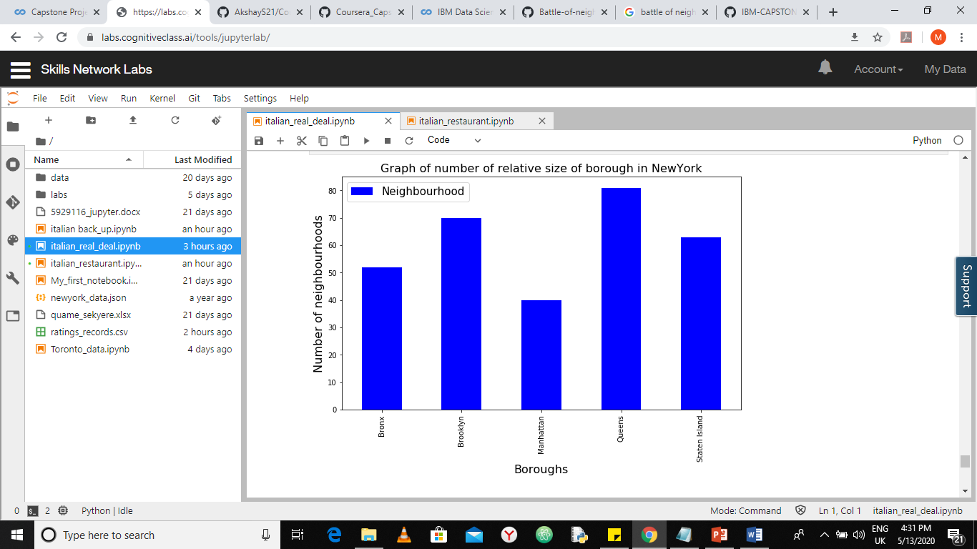
RESULTS bar chart representation of the number of neighborhoods present in each borough of New York

Slide 6
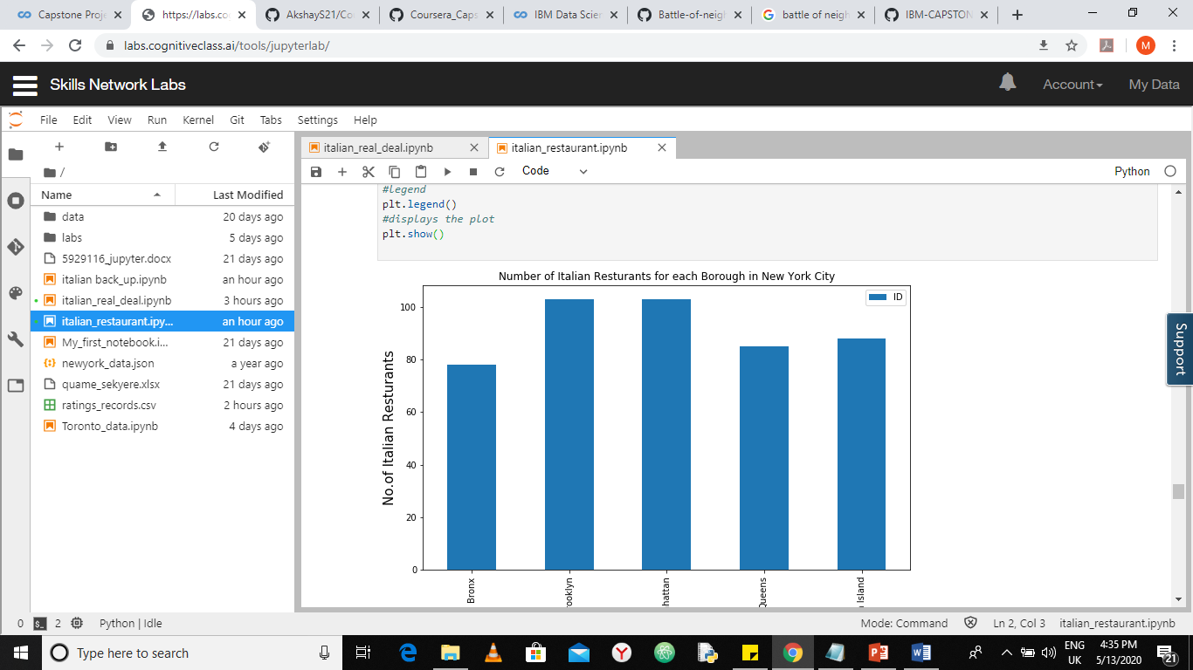
Figure2: bar chart representation of the number of Italian Restaurants present in each borough of NY

Slide 7
CONCLUSION
The Bronx contains venue for some of the best Italian dishes in New York
Brooklyn and Manhattan have potential Italian Restaurant Market
The Bronx is the best place to stay if you prefer Italian Cuisine.
The ranking is purely on basis of rating of restaurants
The accuracy of data depends purely depends on the data provided by Foursquare

